Slide 1

This is a {main title}

Slide 2


{title}
{content}

Slide 3
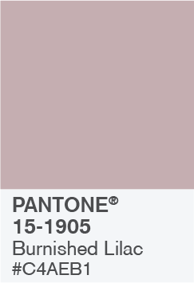
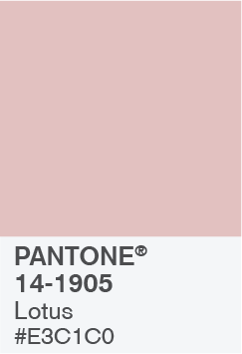
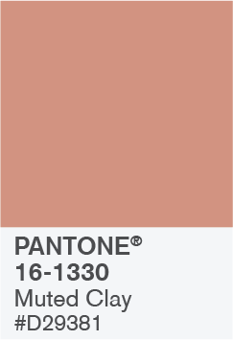

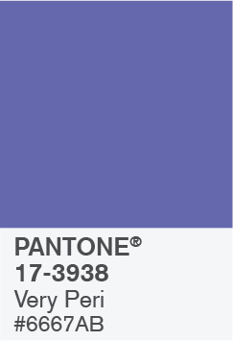

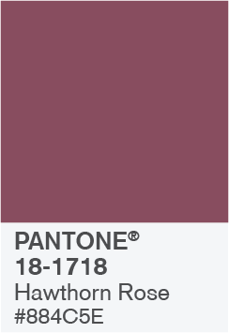
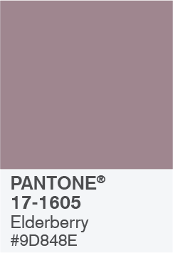
BALANCING ACT

Slide 4

BALANCING ACT
Use this color palette when you want a balance between warm and cool. PANTONE Very Peri is intensified within this artfully calibrated palette, injecting a feeling of liveliness and visual vibration.
a | b | c | d | e | f | g | h
{cell_content1} |  | {cell_content2}
 |  |  |  | {cell_content1}

Slide 5







WELLSPRING

Slide 6

WELLSPRING
Use this color palette when you want a blend of nature-infused hues that highlight the compatibility of the greens and the “health giving” properties of these deliciously subtle and nourishing hues.

Slide 7


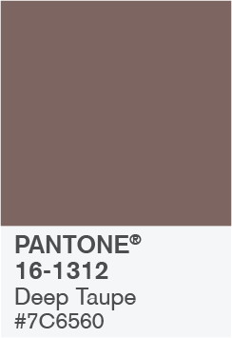


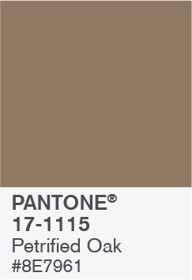

THE STAR OF THE SHOW

Slide 8

THE STAR OF THE SHOW
When you want a more elegant approach, the dynamic presence of PANTONE Very Peri shines as the star of the show in this palette of classics and neutrals whose understated stylishness conveys a message of timeless sophistication.

Slide 9
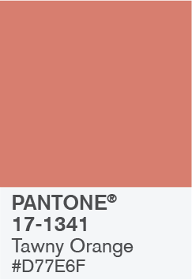


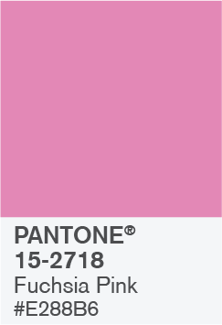
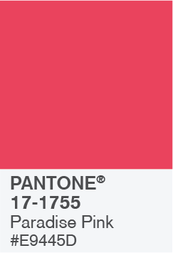


AMUSEMENTS

Slide 10

AMUSEMENTS
Use this color palette when you want to tell a joyous and whimsical story. In this palette, PANTONE Very Peri injects a sense of playful freshness into the design, exuding a good-natured warmth that quickly engages the eye.

Slide 11
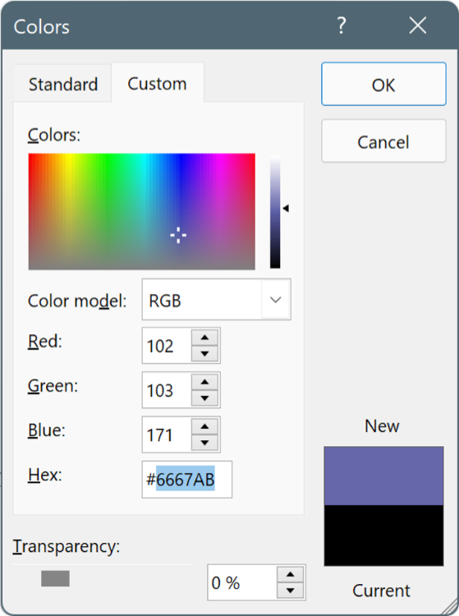
USE THESE COLORS IN ANY POWERPOINT PRESENTATION
Select a shape or text box border. When you do that, the Shape Format tab appears.
On the Shape Format tab, select Shape Fill > More Fill Colors.
In the Colors box, select the Custom tab.
Enter the Hex value of the color you want to use.
Tip: To change multiple shapes or text boxes, click the first shape or text box, and then press and hold Ctrl while you click the other shapes or text boxes.

